Slide 1
SUPRAMOLECULAR CHEMISTRY
---an insight
DR. SHYAMA NAIR
ASSO. PROFESSOR
DEPARTMENT OF CHEMISTRY
NSS COLLEGE PANDALAM

Slide 2
SUPRAMOLECULAR CHEMISTRY
Chemistry of molecular assemblies & of intermolecular bonds
Chemistry beyond the molecule & as the chemistry of non- covalent bond
Intermolecular interaction by H bonding, pi-pi interactions, etc…
It shows selectivity or other functionality
Supra molecules are formed by aggregation of molecules, called molecular subunits
Molecular chemistry – covalent bonding
Supra molecular chemistry – molecular interactions
Host – Guest chemistry.

Slide 3
The roots of supra molecular chemistry has reached from three concepts
Fixations : Concept of receptors.
Recognition : principle of selective binding
Co-ordination : interaction and affinity between the partners
Molecular Recognition, Self Organizations and Self Assembly are the central concepts in supra molecular chemistry.

Slide 4
The stability of supra molecular complex depends on two principle;
Principle of pre-organization
Principle of complimentary or structural recognition

Slide 5
HOST-GUEST CHEMISTRY
Host component is an organic molecule or ion whose binding sites converge in the complex
Guest component is any molecule or ion whose binding site diverge in the complex
The host molecule selectively binds the guest molecule to form a stable host-guest complex, through weak non covalent interactions

Slide 6
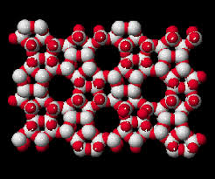
CLASSIFICATION OF SUPRA MOLECULAR HOST & GUEST COMPOUNDS
According to the relative topological relationship between host and guest;
a) Cavitands : Host with intermolecular cavities.
The host, guest aggregrate is called cavitate.
eg : cyclodextrins,calixarenes….
b) Clathrands : Host with extramolecular cavities.
The Host guest aggregrate is called clathrate.
eg : Zeolites MOF …
cyclodextrins
Zeolites

Slide 7
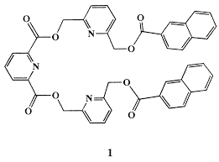
Based on structural features;
a) Podands : Linear or branching chain with guest binding functional group.
High degree of flexibility to conformational change on binding
b) Cyclic host: Nine or more atoms in ring which contain no. of binding sites in a closed – ring arrangement.
They require less conformational change upon binding

Slide 8
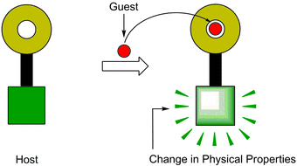
MOLECULAR RECOGNITION
Component of supra molecule have been named receptor and substratre
Receptor (Host) selectively binds substrate (Guest) and form a stable complex
It is mainly through weak forces
According to Lehn, a supra molecular complex is characterized by the energy and the information involved in its binding by the selection of substrates by a given receptor molecule and sometimes by a specific function.

Slide 9
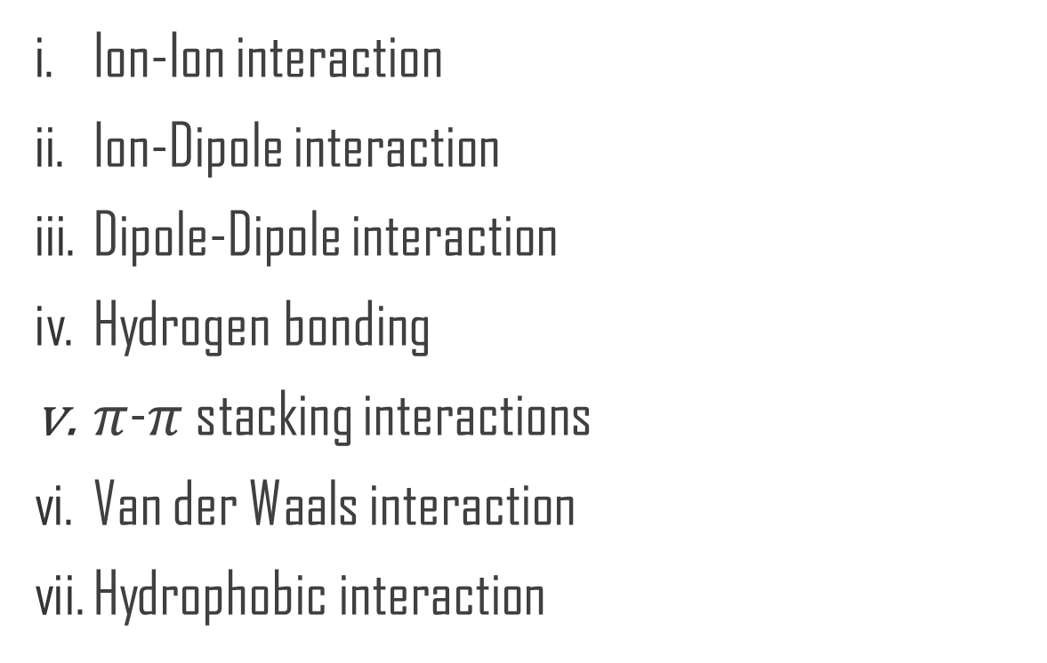
FORCES INVOLVED IN MOLECULAR RECOGNITION

Slide 10
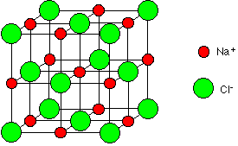
ION-ION INTERACTION
Comparable strength to that of covalent bonding
Bond energy is 100 to350 KJ/mol
It is non- directional in nature

Slide 11
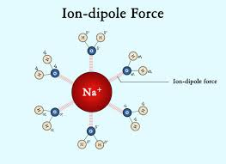
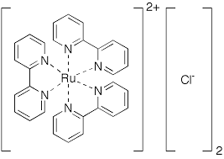
ION-DIPOLE INTERACTION
THE INTERACTION OF ION WITH POLAR MOLECULE
BOND ENERGY IS 50 TO 200 KJ/mol
Usually occur in solid and solutions

Slide 12
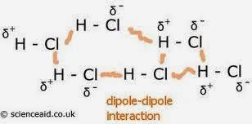
DIPOLE-DIPOLE INTERACTION
Dipole of one molecule interact with dipole of other molecule
Bond energy is 5-50 KJ/mol
The strength of dipole-dipole interaction depends on the size of both dipoles

Slide 13
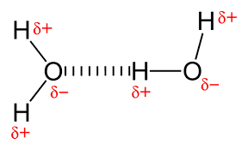
HYDROGEN BONDING
Weakest bond between H atom & other electronegative atom (same or different)
Presence of H bond increase m.p. & b.p.
H bond increase solubility of a substance
H- bonding are represented as D-H-A (D=donor, A=acceptor)
Bond energy is 4-60 KJ/mol

Slide 14
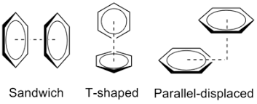
π-π STACKING INTERACTIONS

Slide 15
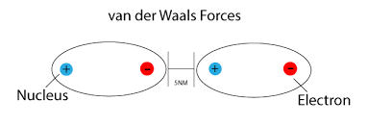
van der waals interactions
Weak electrostatic interactions
Polarization of an electron cloud by positive charge of adjacent nucleus
The bond energy is 0.4-4 KJ/mol
They are non-directional and hence possess only limited scope in the design of specific hosts for selective binding of particular guests.
Two types of VAN DER WAALS INTERACTIONS :
a) London force (dispersion force)
b) Exchange-repulsion force

Slide 16
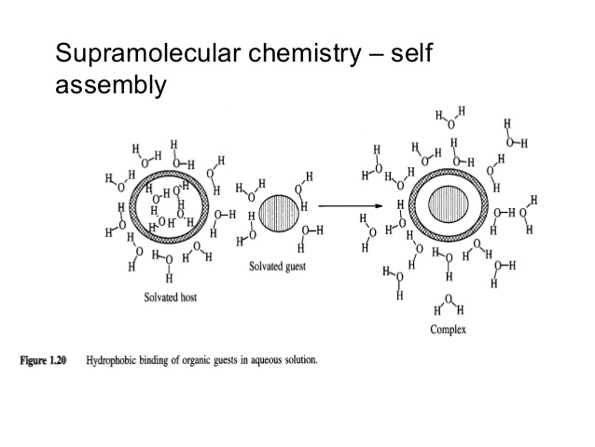
HYDROPHOBIC INTERACTIONS
It arises from the exclusion of non polar groups or molecule from aq. Solution
The energy is less than 40 KJ/mol
The hydrophobic interactions are important in biological system
Hydrophobic effects can be divided into two energetic components
a) Enthalpic hydrophobic effects
b) Entropic hydrophobic effects

Slide 17
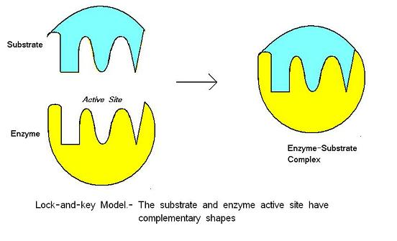
MOLECULAR RECOGNITION IN ENZYME CATALYSIS

Slide 18
THANK YOU

